Slide 1



Forecasting of S&P500 Index
UP
DOWN
With all forecasting methods
Success is not guaranteed!

Slide 2
Logical Diagram of the Research
Literature Research
Data collection
`
Data preparation
Modelling
and metrics
Results comparison

Slide 3

Literature Research
.
Godfrey (1964)
Stock price prediction is considered impossible according to the random walk hypothesis, which states the stock market prices moves just like a random walk
Pilinkus (2010)
The relation between macroeconomic indicators and stock prices is confirmed in the most academic works, although there is a lack of comprehensive assessment of causality and dependence of macroeconomic indicators and stock market regarding the time and changing macroeconomic processes
Prazak’s (2018)
General macroeconomic indicators provide a statistically significant impact on stock prices in the long run, though strength of the impact may substantially
vary among economic sectors
Wirajaya (2019)
Exchange rates can affect domestic investments
such as stocks. This situation will cause a decrease in demand for shares so that stock prices decline.

Slide 4


Data Collection
Research periods:
01.01.2010-28.02.2022 (Monthly Basis)
01.01.2019-28.02.2022 (Daily Basis)
A
B
Price of the S&P 500 index
Data of economic indicators

Slide 5
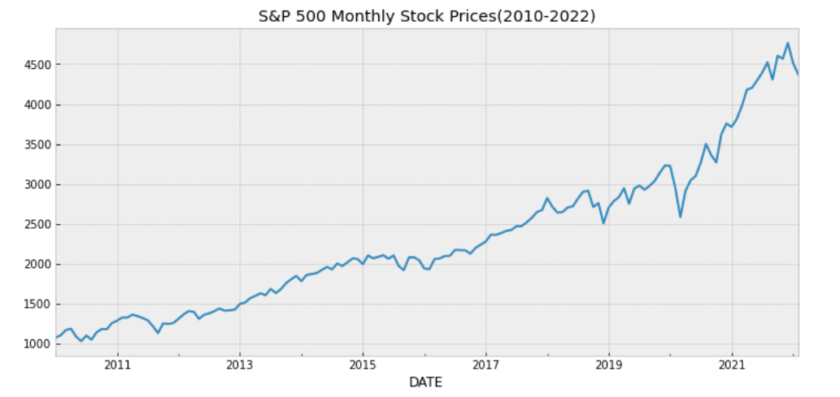
Data Exploration

Slide 6
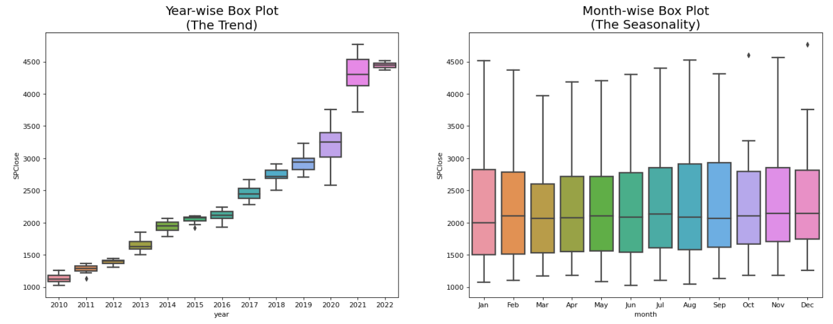
Trend & Seasonality
Trend: The linear increasing or decreasing behavior of the series over time.
Seasonality: The repeating patterns or cycles of behavior over time.

Slide 7
Economic Indicators
Macroeconomics | Labour Market | Real Estate Market | Credit Market | Monetary Supply | Consumer financial behaviour | Commodity Marekt
Consumer Price Index | Unemployment rate | Housing starts | Intrest rate | M1 | Real disposable personal income | Oil price
Industrial Production Index | Labour force participation rate | New private housing building permits | Treasure Bill | M2 | Personal saving | Motor vehicle retail sales
Inflation rate |  |  | Comercial & industrial loans | Funds Rate | Demand deposits | Gold price
 |  |  | Bank prime loan rate | Currency in cerculation | Personal savings rate
 |  |  | Bank credit | 10 Year treasury | Personal consumption expenditures

Slide 8
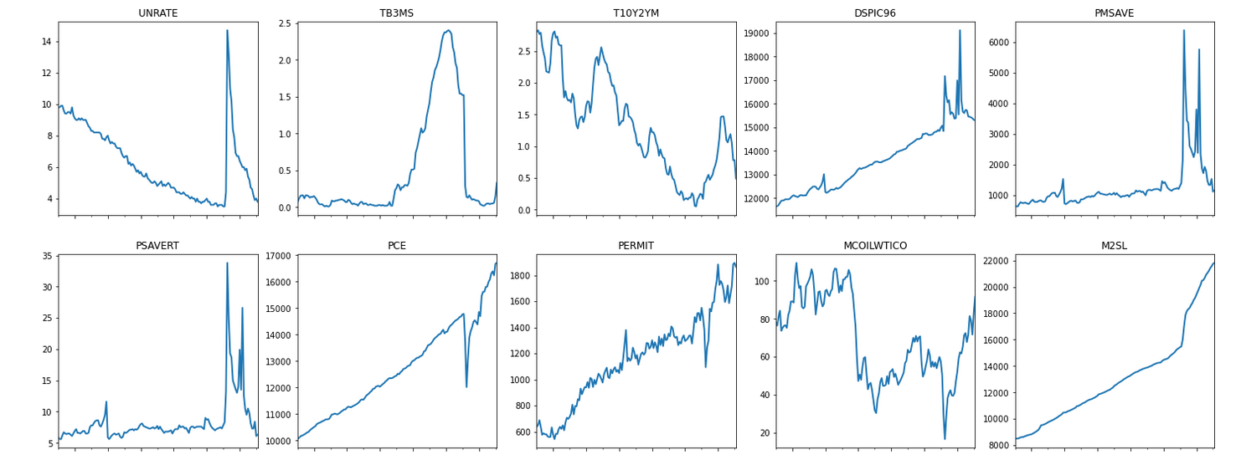
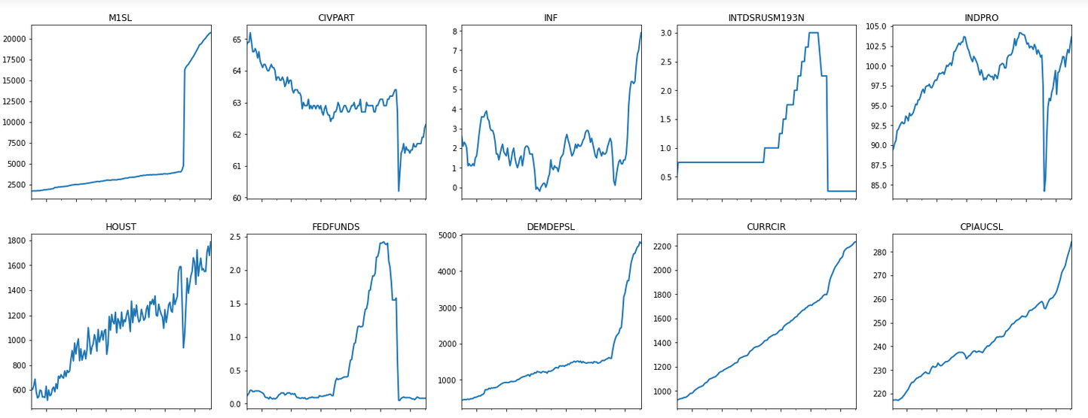
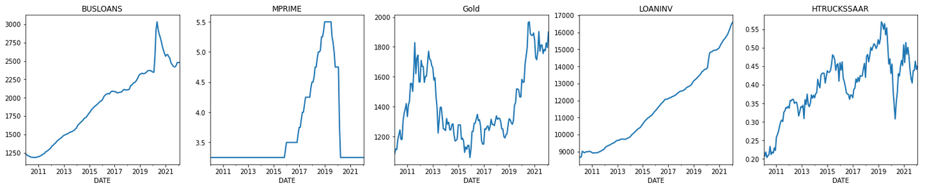

Slide 9

Data Preparation
D
A
Normalization
Test Stationarity
C
B
Achieve Stationarity
Feature Selection

Slide 10
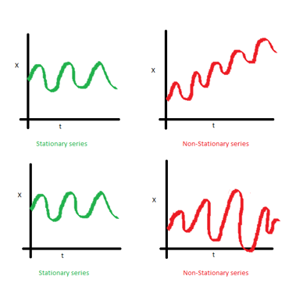
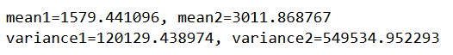
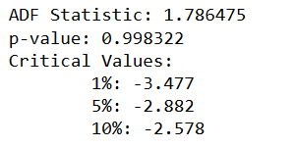
Stationarity
Stationary Series: where the values of the series is not a function of time.
- Mean, variance are constant over time.
How to test stationarity?
- Summary Statistics: Split the time series into two contiguous sequences, then calculate the mean and variance of each group.
- Statistical Tests: ex. ADF test. If p-value > 0.05: Fail to reject the null hypothesis (H0) : the data is non-stationary.

Slide 11
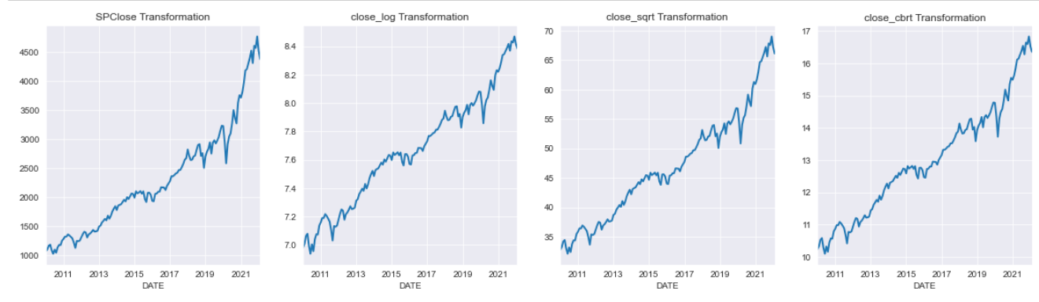
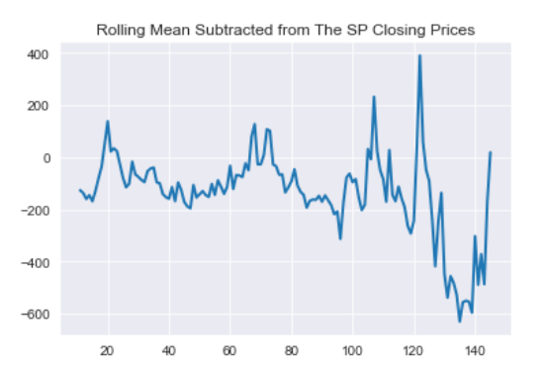
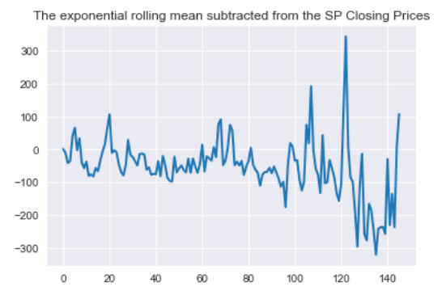
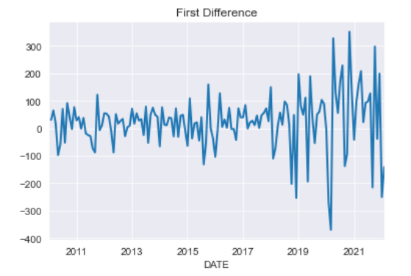
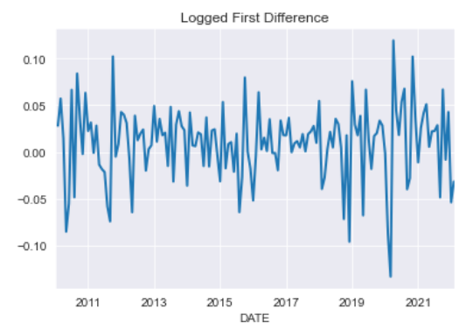
Achieving Stationarity

Slide 12
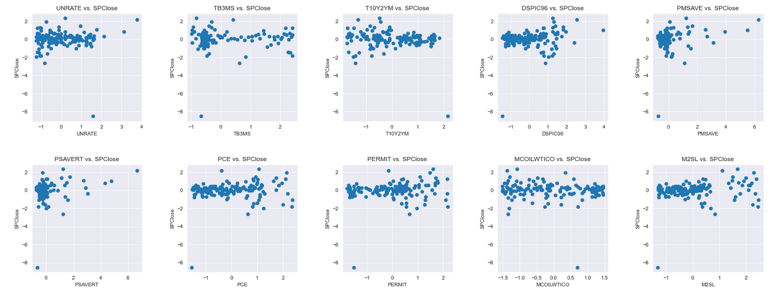
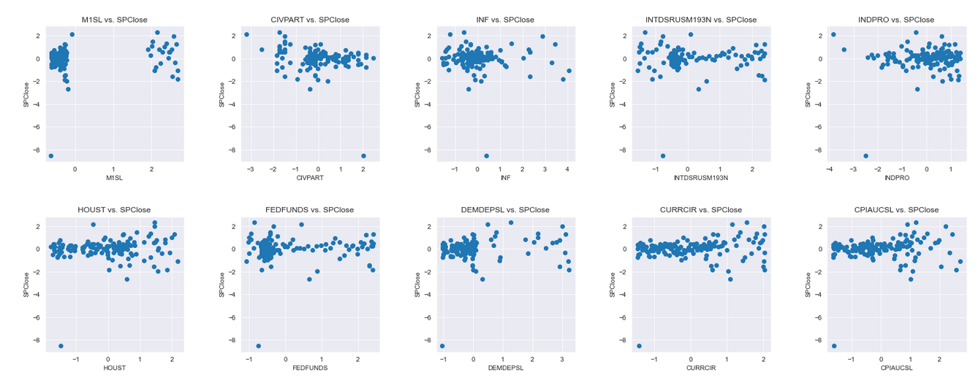
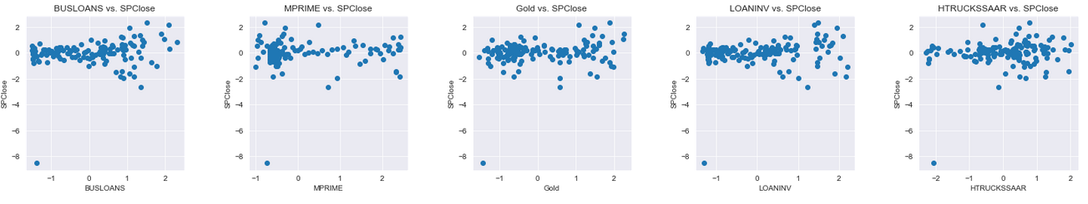

Slide 13
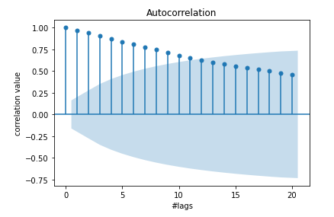
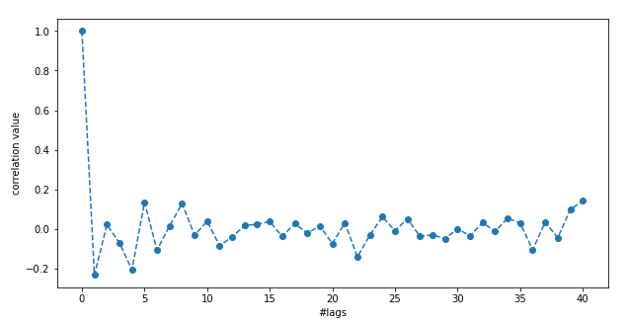
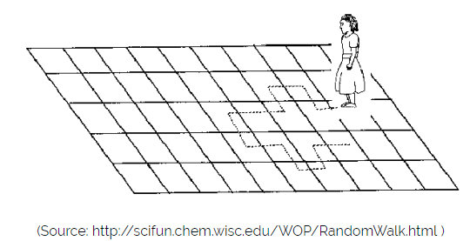
Random Walk?
X(t) = X(t-1) + Er(t)
The current observation is a random step from the previous observation.
No obviously learnable structure in the data.
naive forecast

Slide 14
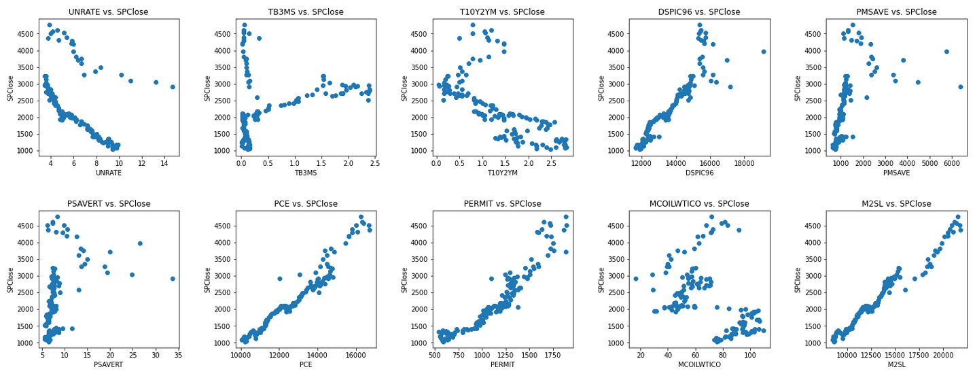
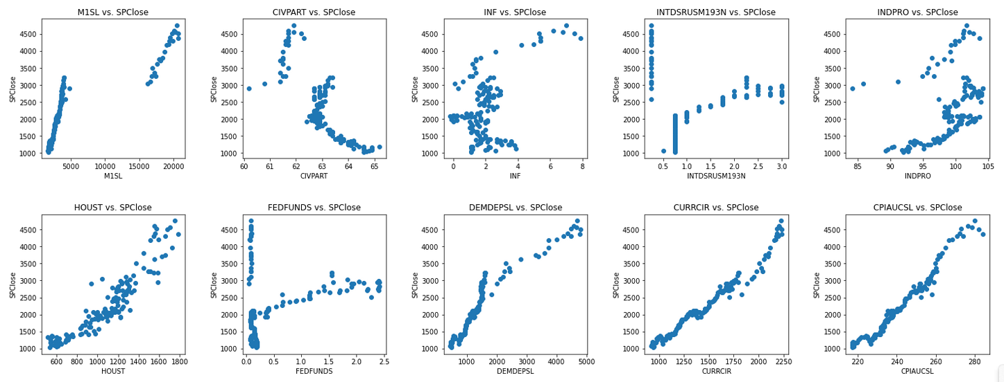
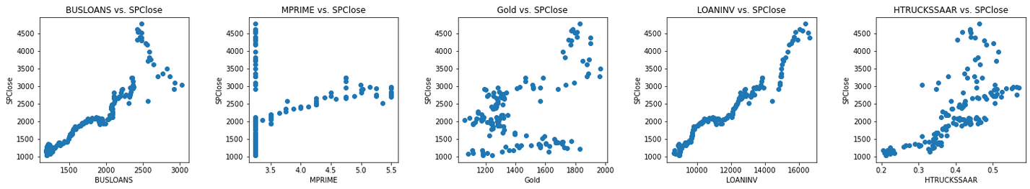

Slide 15
Features Selection
Causal Inference
.
D
A
B
C
Visualization
Multicollinearity
Normalization
.
.

Slide 16
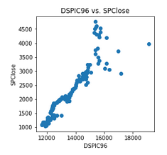
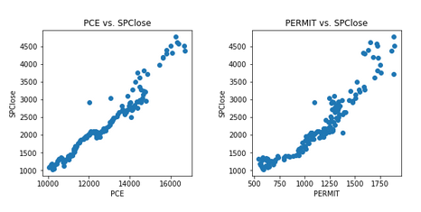
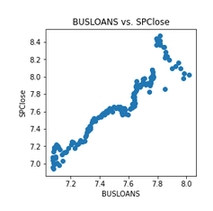
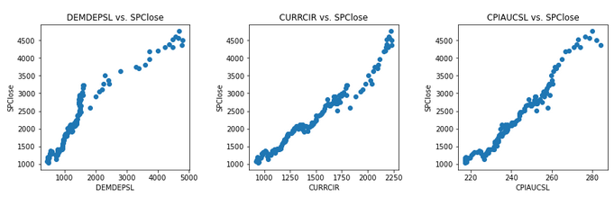
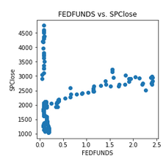
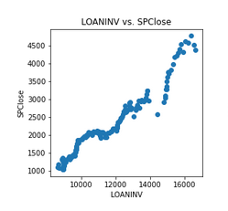
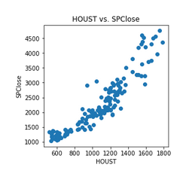
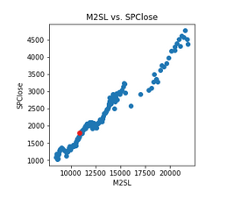
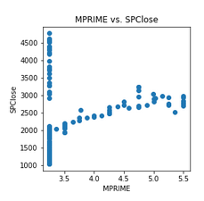
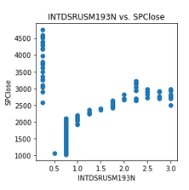
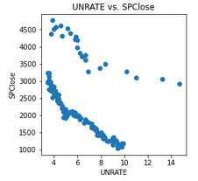
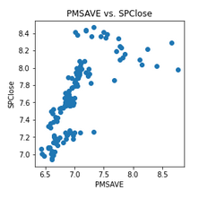
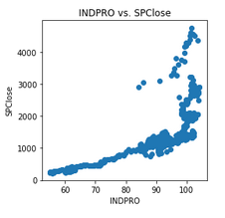
Visualization

Slide 17
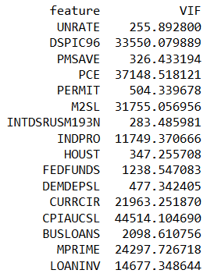
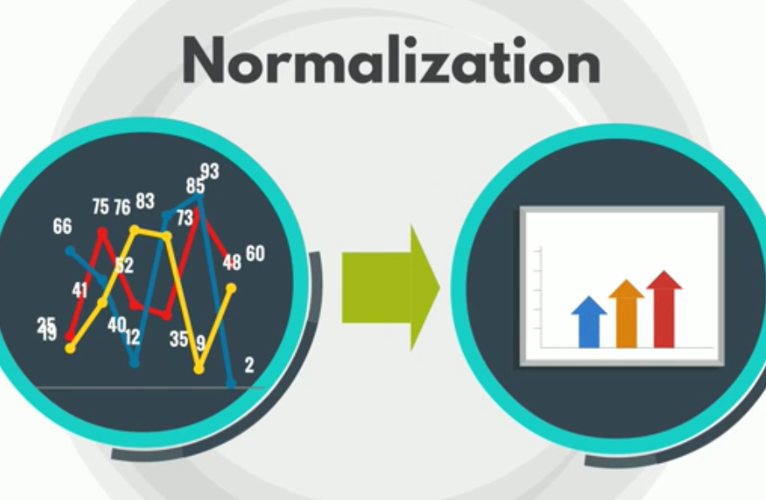
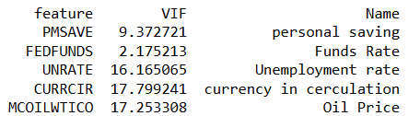
Multicollinearity
when there’s correlation between independent variables in a model
VIF test > 10 indicates high correlation.

Slide 18
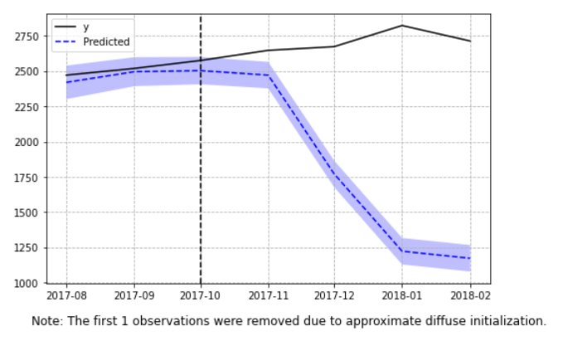
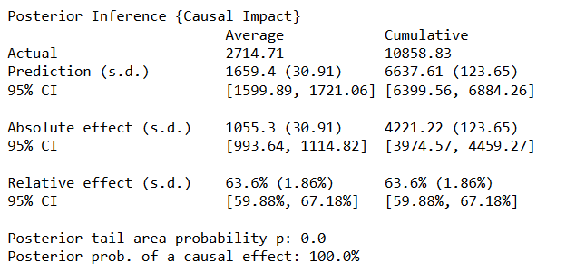
Causal Inference
A
Bayesian structural time-series models
SPClose vs FEDFUNDS
Ceteris paribus
Statistically Significant: p-value <= 5%

Slide 19
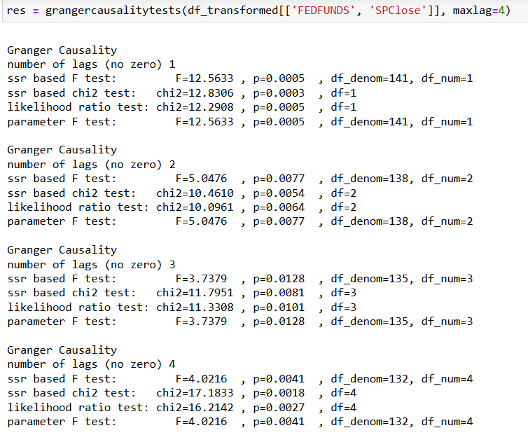
Causal Inference
B
Granger Causality in Time Series
SPClose vs FEDFUNDS
Stationary Data
Statistically Significant: p-value <= 5%

Slide 20
Modelling
Supervised learning
Regression
Classification
DL
RNN , LSTM NeuralProphet
ML
Linear reg, Random Forest
XGB
ML
Linear, log reg, Random Forest
Prophet

Slide 21
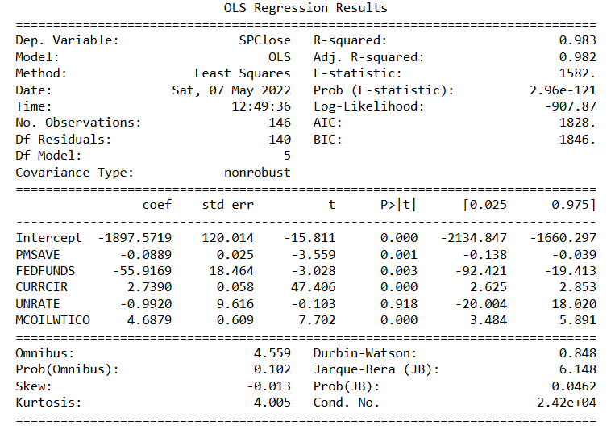
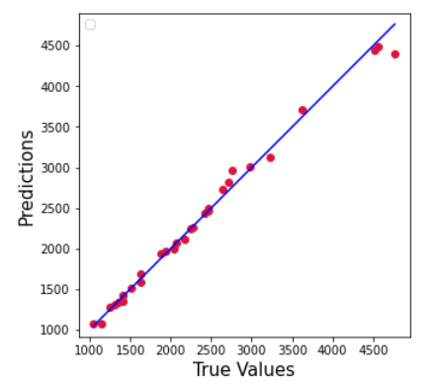
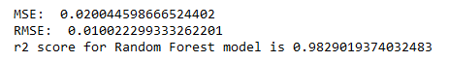
Linear Regression Model
SPClose = 𝛽0 + 𝛽1UNRATE+ 𝛽2 FEDFUNDS + 𝛽3 MCOILWTICO+ 𝛽54CURRCIR+ 𝛽5 PMSAVE+ 𝜀

Slide 22
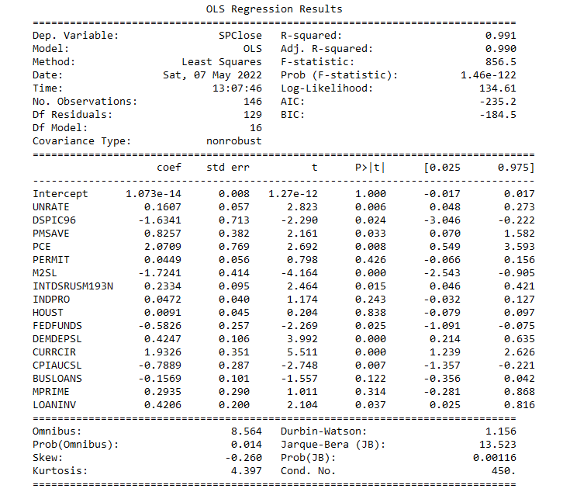
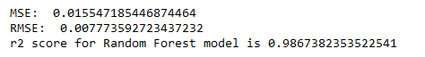
Linear Regression Model
all the economic indicators
SPClose = 𝛽0 + 𝛽1UNRATE+ 𝛽2 FEDFUNDS + 𝛽3 MCOILWTICO+ 𝛽54CURRCIR+ 𝛽5 PMSAVE+……. +𝜀
small data set

Slide 23
Almost There!

